Slide 1
BB2950 Day 22: Monday 12-4-17
Learning objectives:
Compare and contrast the mechanisms of mRNA degradation in bacteria and in eukaryotes.
Describe the general types of processing required to produce mature rRNAs and tRNAs in both bacteria and eukaryotes.
Describe the major features that are shared among tRNAs.
Describe the RNA and protein components of ribosomes and their general roles.
Define and explain the roles of the ribosomal A, P, and E sites.

Slide 2
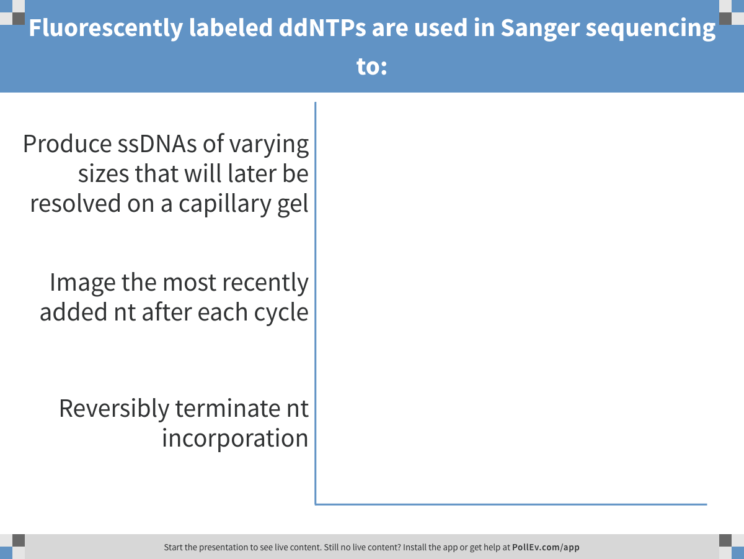
Notes:
Fluorescently labeled ddNTPs are used in Sanger sequencing to:
https://www.polleverywhere.com/multiple_choice_polls/aEq9s2LTGJAdRbz

Slide 3
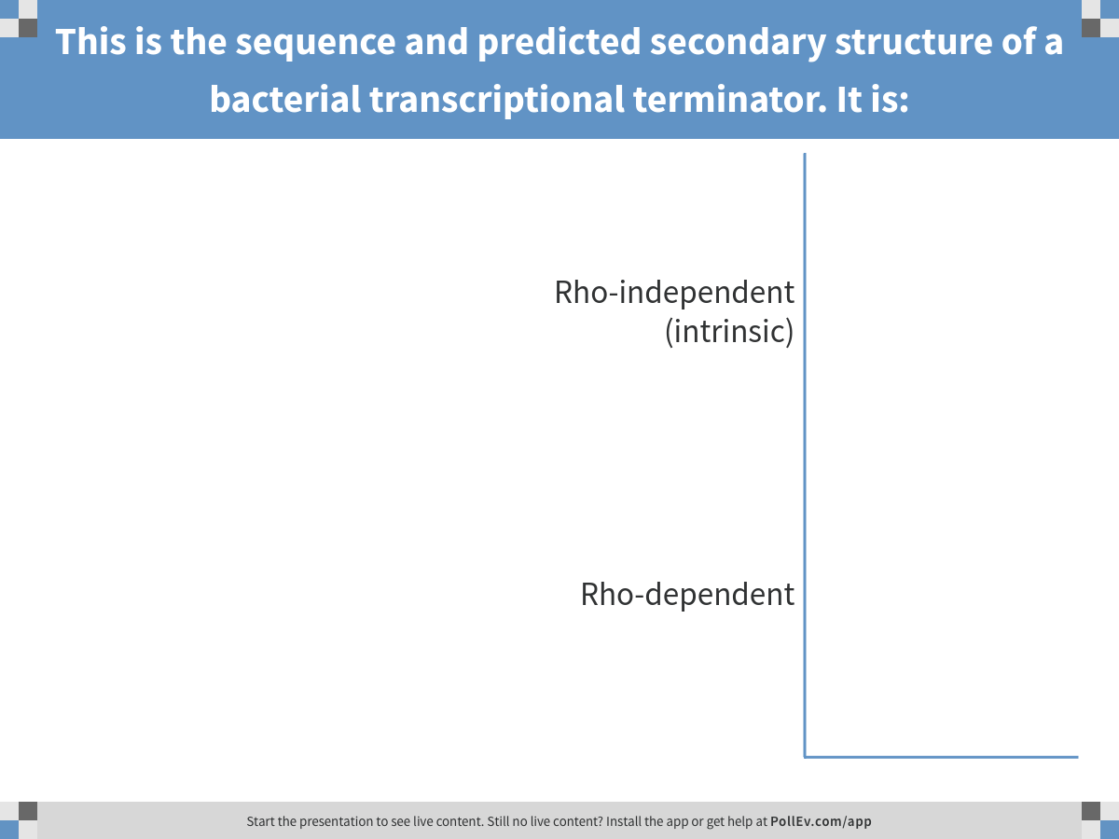
Notes:
This is the sequence and predicted secondary structure of a bacterial transcriptional terminator. It is:
https://www.polleverywhere.com/multiple_choice_polls/SyGVeHeGVxklqy3

Slide 4
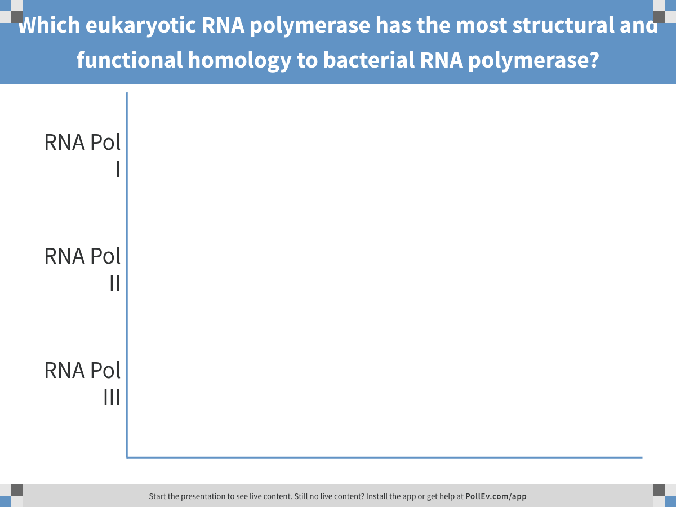
Notes:
Which eukaryotic RNA polymerase has the most structural and functional homology to bacterial RNA polymerase?
https://www.polleverywhere.com/multiple_choice_polls/Cw0SPSE6n0pprTk

Slide 5
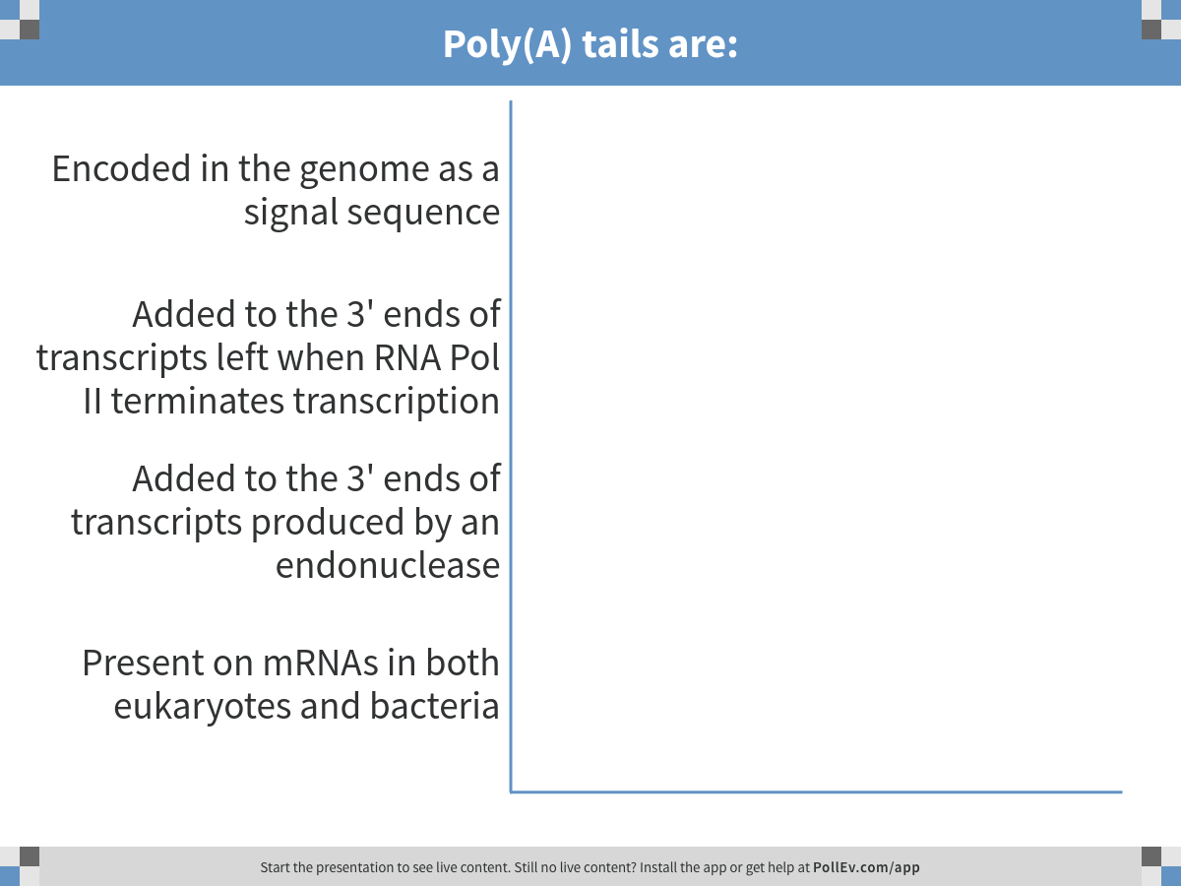
Notes:
Poly(A) tails are:
https://www.polleverywhere.com/multiple_choice_polls/3fD4ItSV7AYB68K

Slide 6
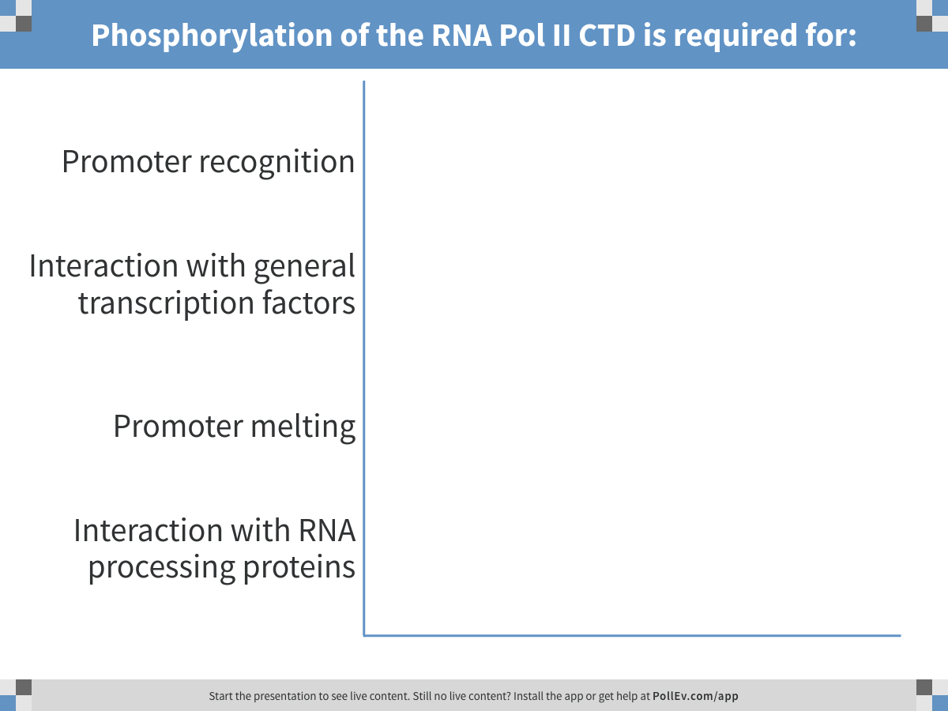
Notes:
Phosphorylation of the RNA Pol II CTD is required for:
https://www.polleverywhere.com/multiple_choice_polls/sZOLB2rZyBO9RGR

Slide 7
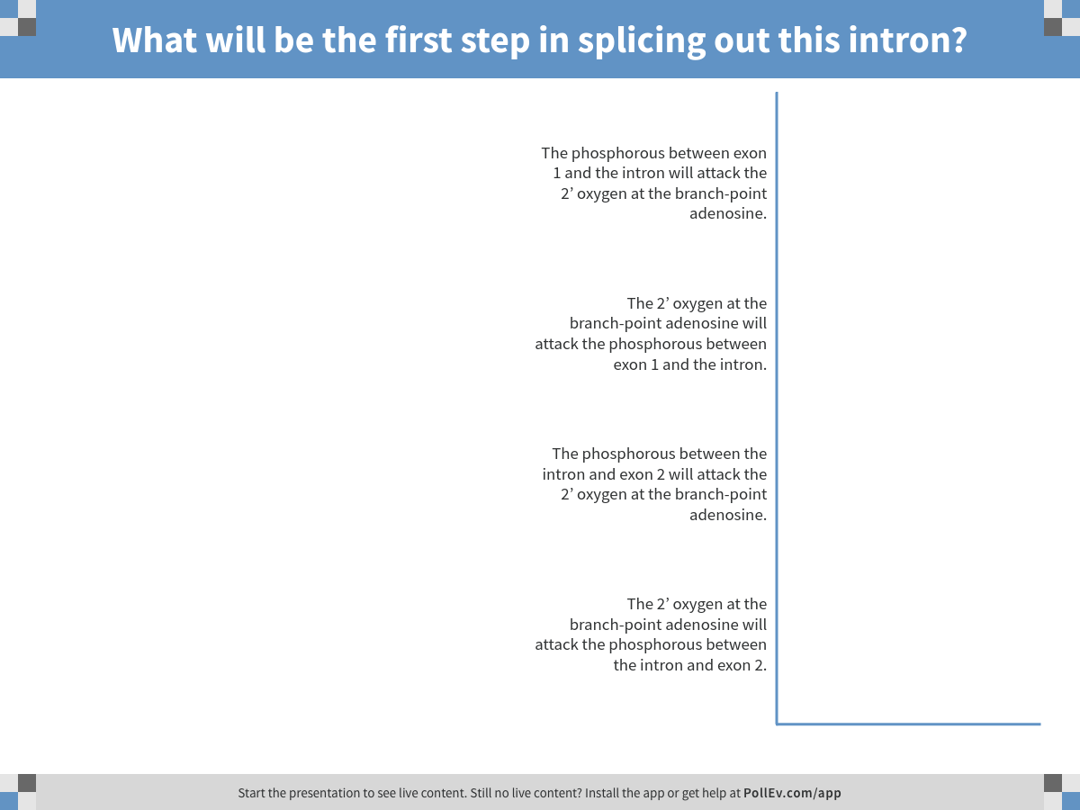
Notes:
What will be the first step in splicing out this intron?
https://www.polleverywhere.com/multiple_choice_polls/PR12nvFCi5tuPfr

Slide 8
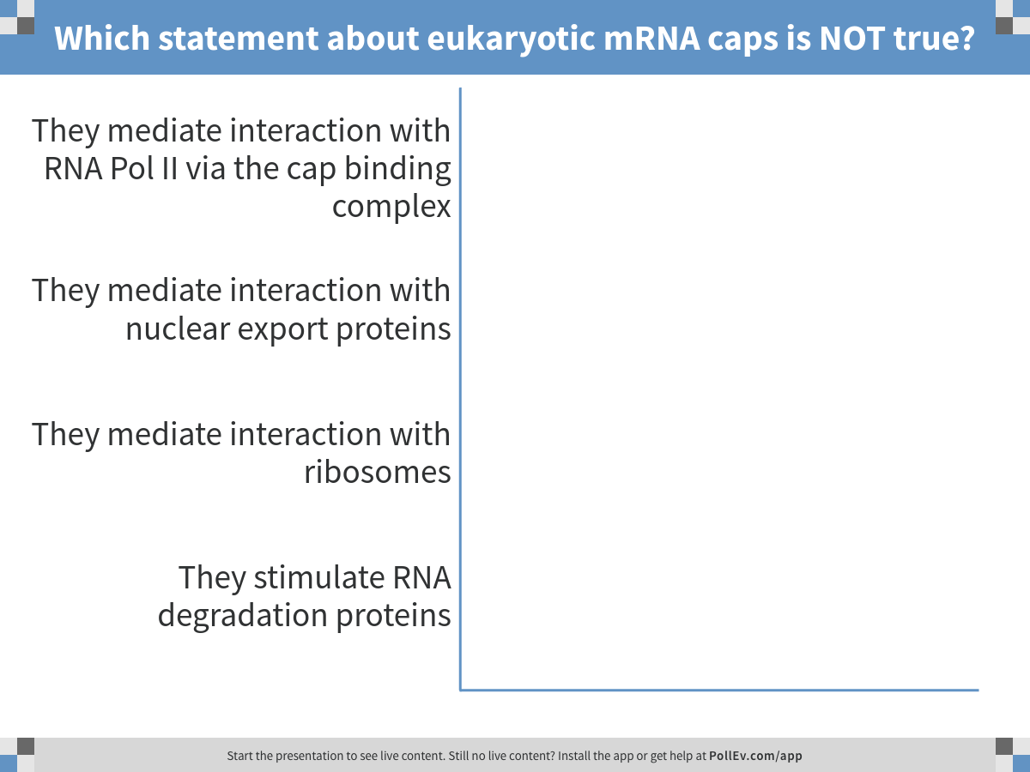
Notes:
Which statement about eukaryotic mRNA caps is NOT true?
https://www.polleverywhere.com/multiple_choice_polls/sCHV7LqyHIWchS1

Slide 9
mRNA degradation
mRNA half-lives vary from gene to gene
Generally much longer in eukaryotes than in bacteria
Eukaryotes: removal of cap and poly(A) tail stimulate degradation.
Bacteria: removal of 5’ triphosphate and endonucleolytic cleavage stimulate degradation.

Slide 10
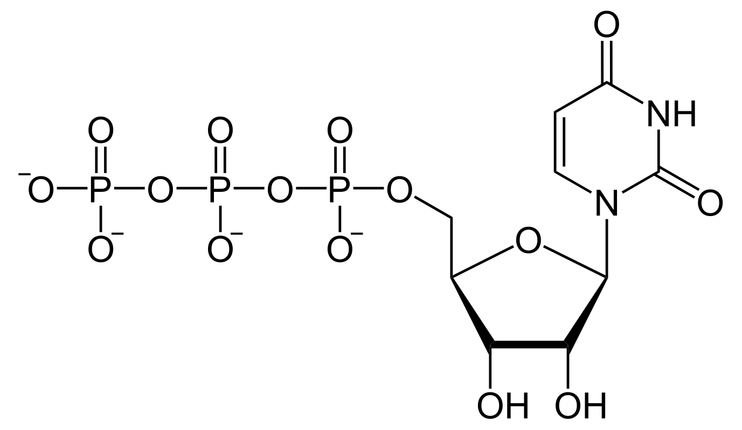
RNA polymerization results in a 5’ triphosphate

Slide 11
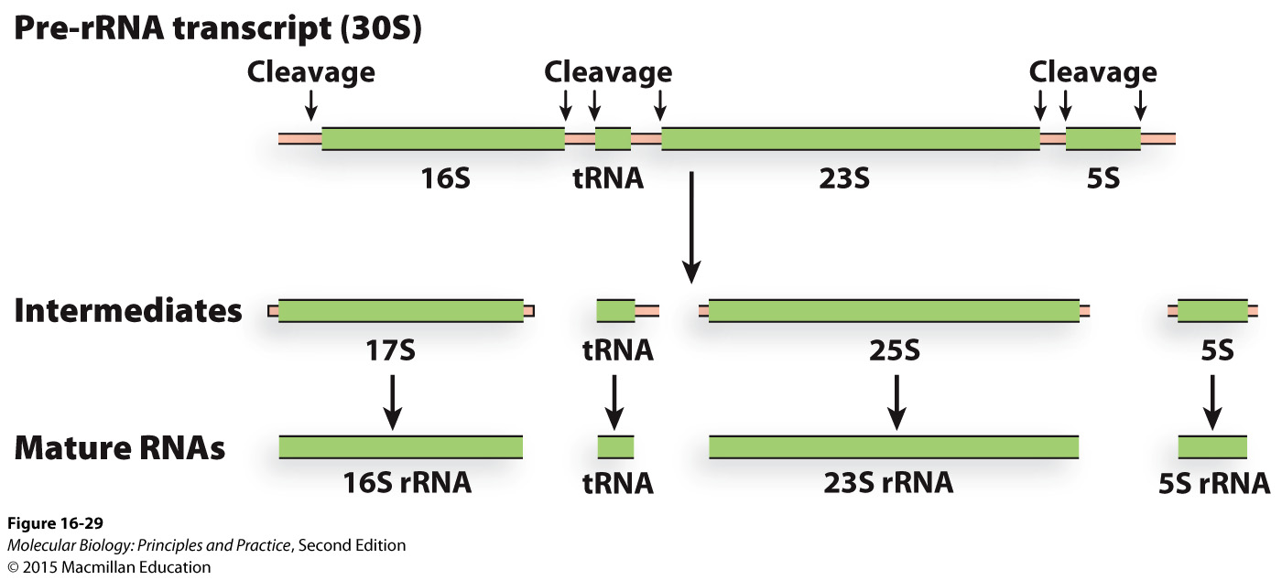
Bacterial rRNAs and tRNAs must be processed by RNases

Slide 12
Enzyme naming: something-ase often adds, removes, or degrades the something
DNase: degrades DNA
RNase: cleaves or degrades RNA
Protease: degrades protein
Phosphatase: removes phosphate groups (dephosphorylation)
Lipase: cleaves lipids

Slide 13
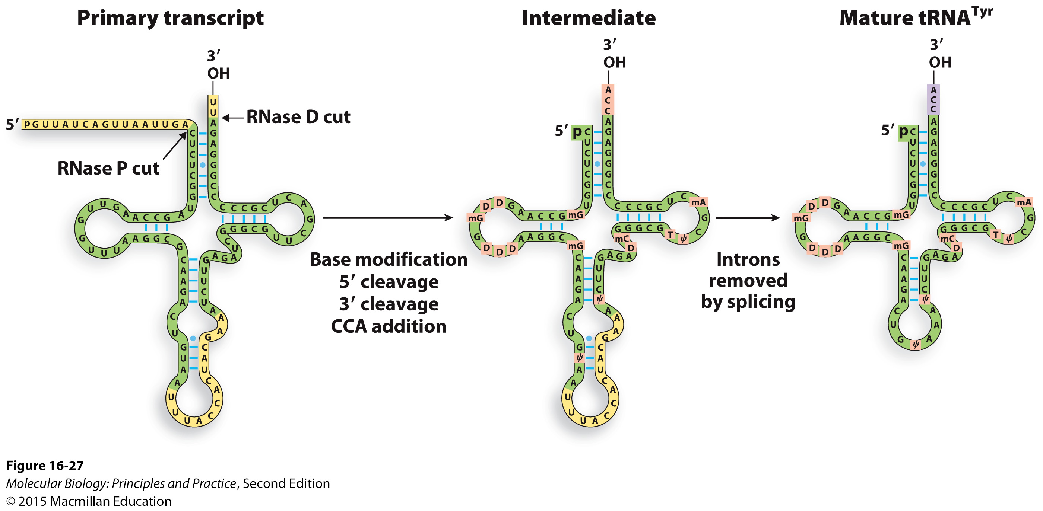
tRNA processing

Slide 14
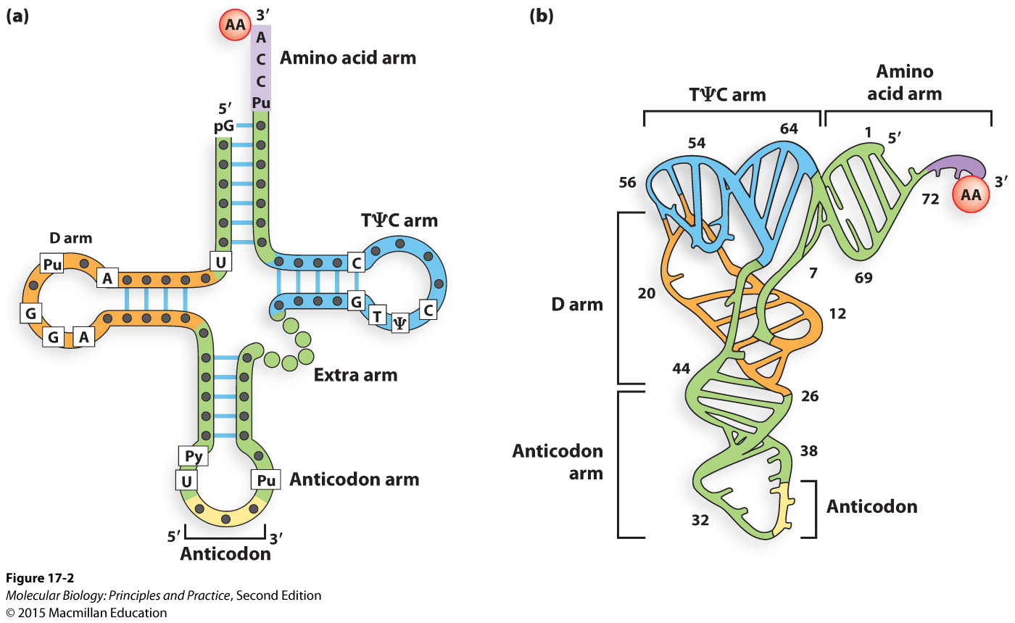
General features of tRNAs

Slide 15
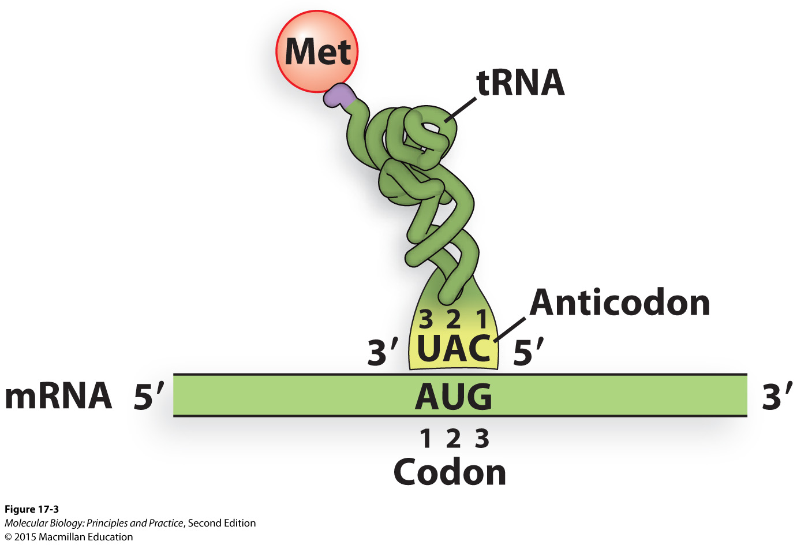
A schematic view of an aminoacylated (“charged”) tRNA

Slide 16
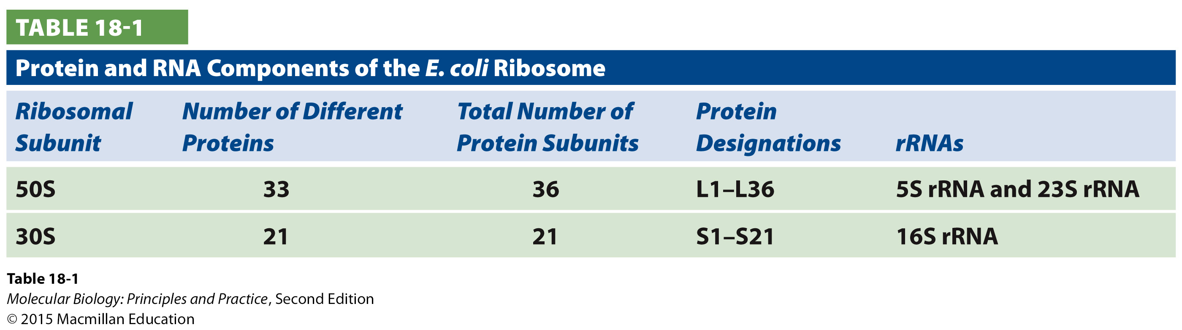
Ribosomes are large RNA-protein complexes

Slide 17
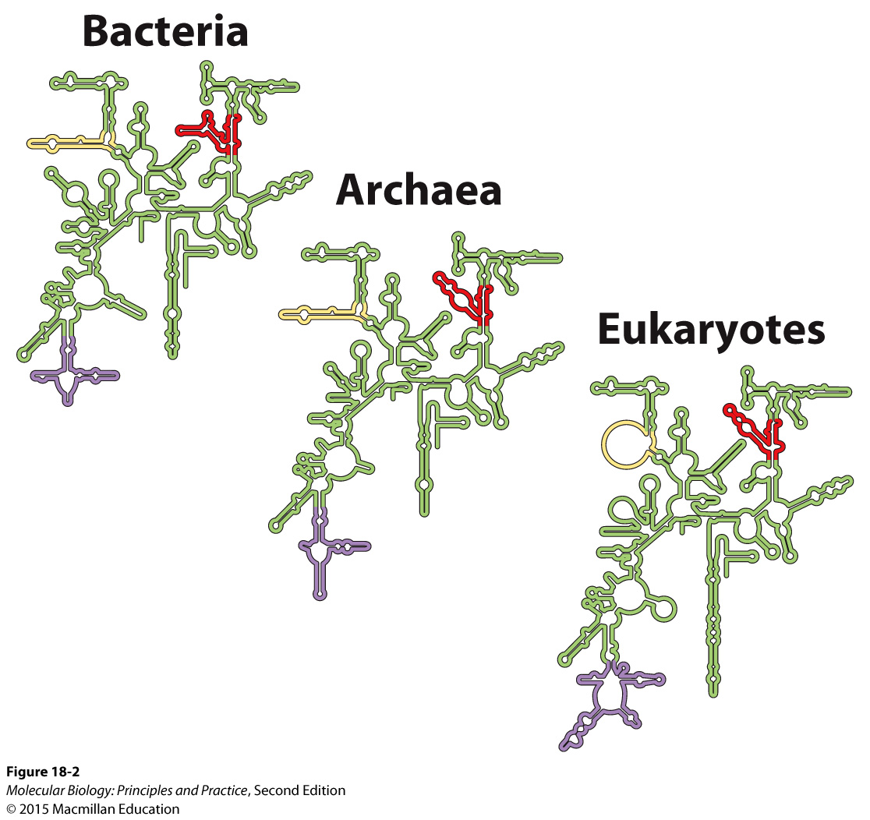
rRNA secondary structure is highly conserved

Slide 18
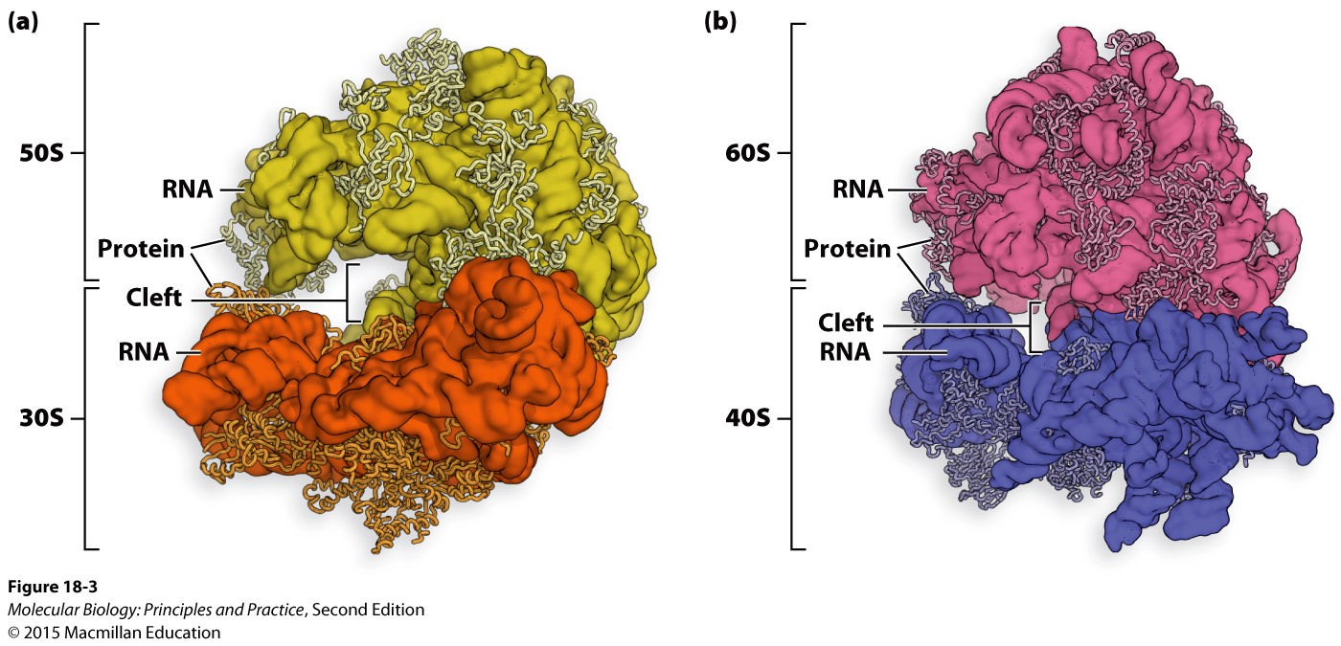
Overall ribosome structure is highly conserved
mRNA runs through cleft between small and large subunits
Proteins are mostly on the outside

Slide 19
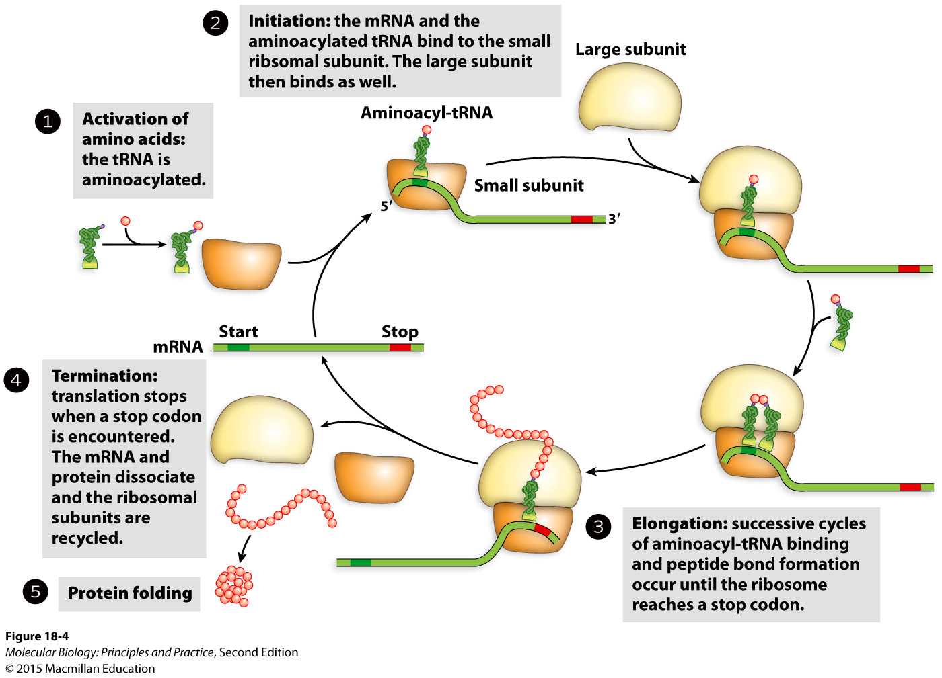

Slide 20
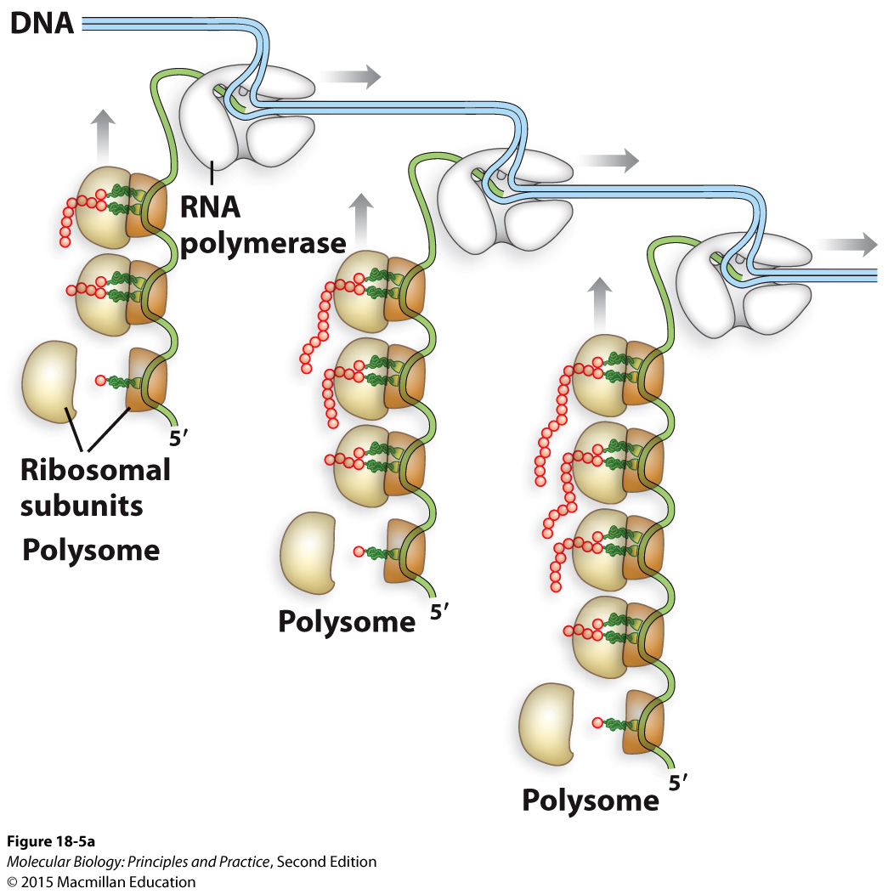
Transcription and translation are coupled in bacteria

Slide 21
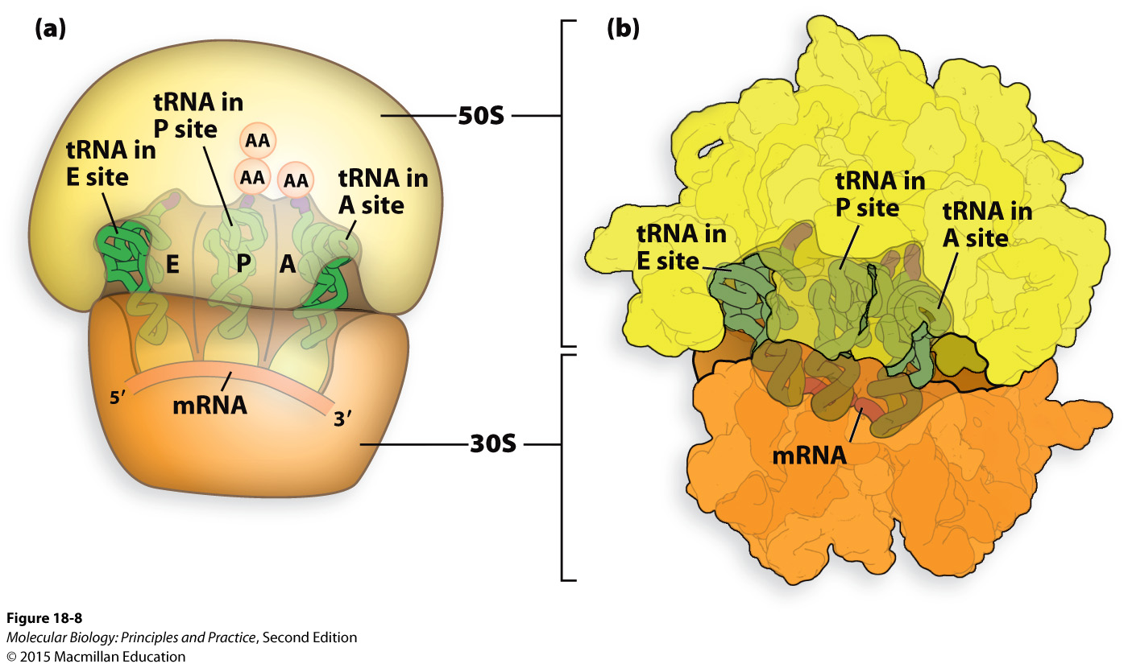
Ribosomes have three tRNA binding sites

Slide 22
Exam 2 grade distribution
Median: 80.25
Mean: 79.61

